Slide 1
Text classification & summarization
By Connor Meek

Slide 2
Background
Text classification was looking at a fake news dataset and determining which ones are real or fake by looking at the title (would’ve been text too).
The text summarization was looking at a article online, which itself was about a recent machine learning research project from Australia. I’ll circle back to the details of the story later; however, the “data” was just the article from NPR’s website.

Slide 3
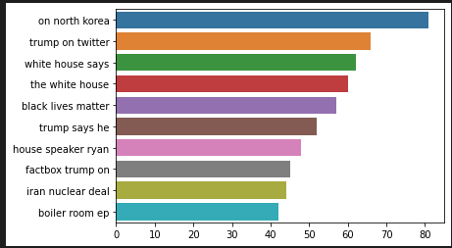
Data analysis (text classification)
The fake news data contained a total of 24,338 observations, with 13,239 being real stories and 11,099 fake stories.
The avg title length was around 50 characters.
The 10 most common ngrams, with length 3.
Ngrams at length 3 (trigrams) returned the most interesting results from my trails

Slide 4
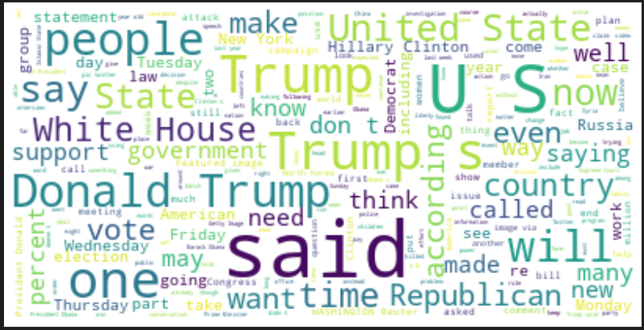
Data analysis cont (text classification)
The terms generated from the trigrams are spicy terms and are headlines you’d expect to see. On a word level, we can view this is a wordcloud and see which are the most common that way.

Slide 5
Data analysis (summarization)
Analyzing a text for summarization isn’t as straight forward as classification. There are basic stats to look at, like word or char count.
806 words
3,859 characters (total minus spaces)
Tagging Parts of speech, IE labeling ‘John’ as a person and so on.
Topic modeling, weighting key words together that hopefully point toward a topic.
Creating a table for most frequent words.

Slide 6
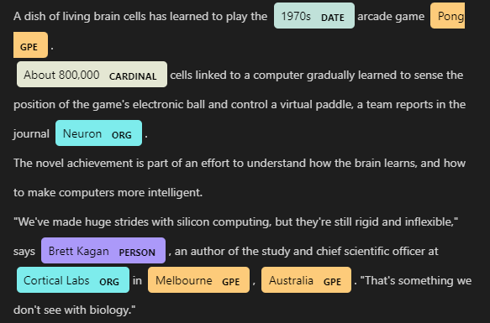
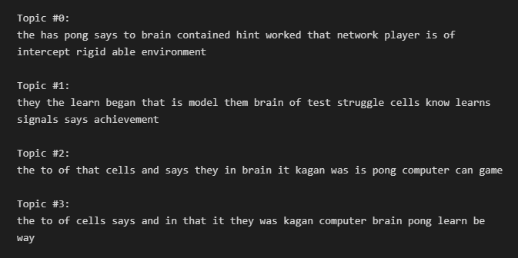
Data analysis Cont (summarization)
Tagging POS, using spacy
Topic modeling via LDA

Slide 7
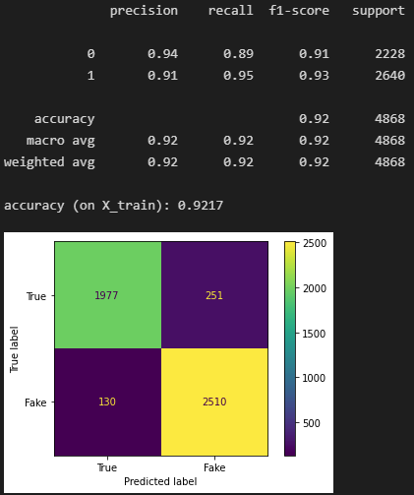
Baselines
For text classification, I ended up using a random forest classifier, tweaking the hyper parameters using n_esimators at 100 (# of trees in the forest) and used log loss as the loss function.
I also tried my best performing classifier from assign 3 although it didn’t do as well, it was close.

Slide 8
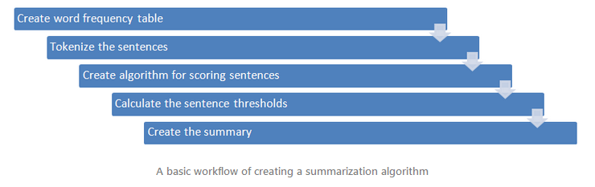
summarization Baseline
A baseline for summarization, depends on the type, with extraction base summarization there is an algorithm that I found online, which I think does well.
Source: https://blog.floydhub.com/gentle-introduction-to-text-summarization-in-machine-learning/
Each step is (basically) a function

Slide 9
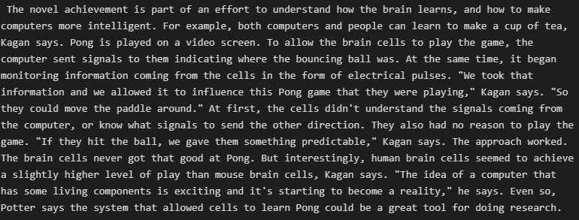
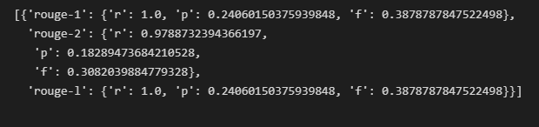
summarization Baseline Result
Here is the summary generated by the baseline:
When evaluating these summary results, there is a fair bit of subjective, but reading it over, it isn’t all that coherent. Although, it did get the gist of the story.
Rouge:

Slide 10
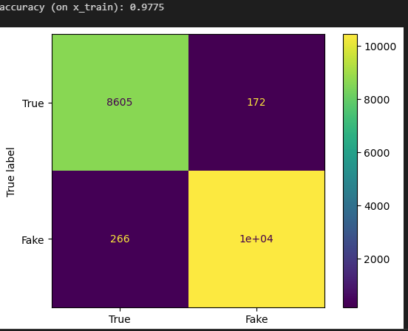
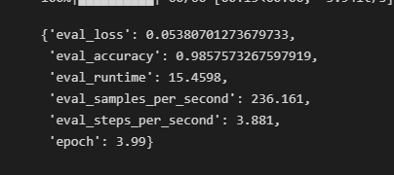
Sota model
I tried a real simple neural net for the text classification problem, for the ANN, I used 1 hot encoding and keras library to implement. I’ll also tried the huggingface model using bert based cased.
ANN
BERT

Slide 11

Sota model for summarization
For the summary of the text, I just called a pipeline from the transformers library and within the pipelines they have categories for sentiment analysis, text generation, and of course summarization.
Bit of a side note, this method is limiting as it only takes around 800 words. This is why I used the story from NPR, it basically meet that requirement.

Slide 12
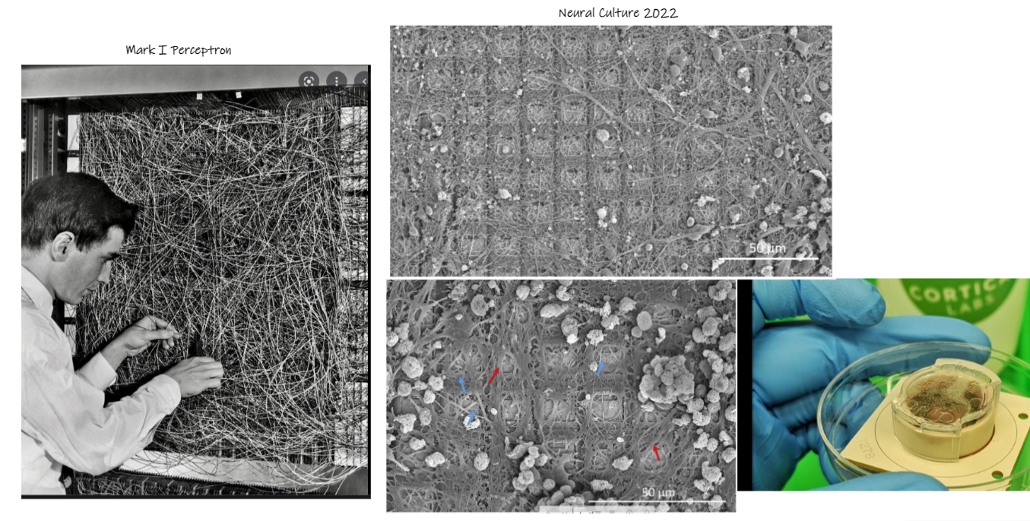
Into the story

Slide 13
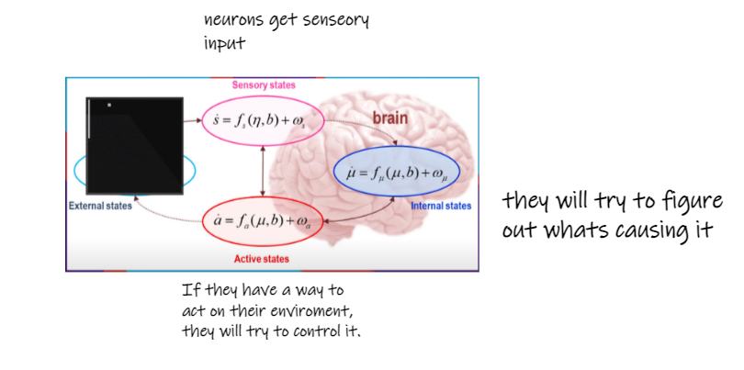
“Understanding” the brain
The research team defines brains as “self organizing sense making machines.”

Slide 14
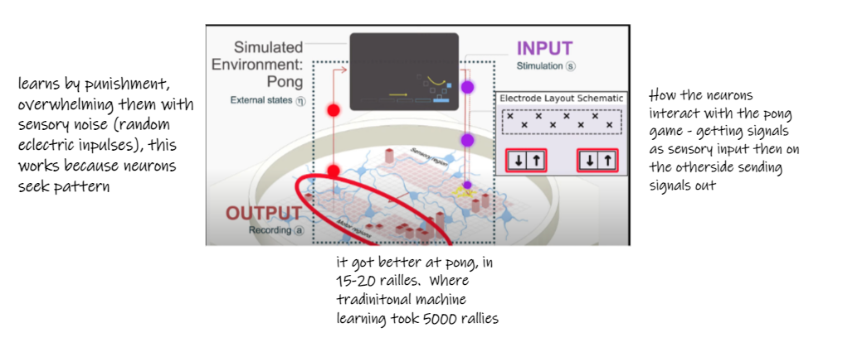
More on the results
Basing the experiment from Karl Friston’s Free Energy Principle and active inference. Neurons model the world by minimizing surprises in their environment. This is applied by sending sensory input to the dishbrain and controlling the input via hitting or missing the ball.

Slide 15
End & sources
https://www.frontiersin.org/articles/10.3389/fncom.2020.00030/full
https://iai.tv/articles/neurons-in-a-dish-learn-to-play-pong-auid-2058
https://webcache.googleusercontent.com/search?q=cache:Q4GbmFgMTFcJ:https://www.newscientist.com/article/2301500-human-brain-cells-in-a-dish-learn-to-play-pong-faster-than-an-ai/&cd=5&hl=en&ct=clnk&gl=us&client=firefox-b-1-d
https://www.youtube.com/watch?v=67r7fDRBlNc

